Slide 1
Butterflies mummification
By the wonderful little tosha

Slide 2
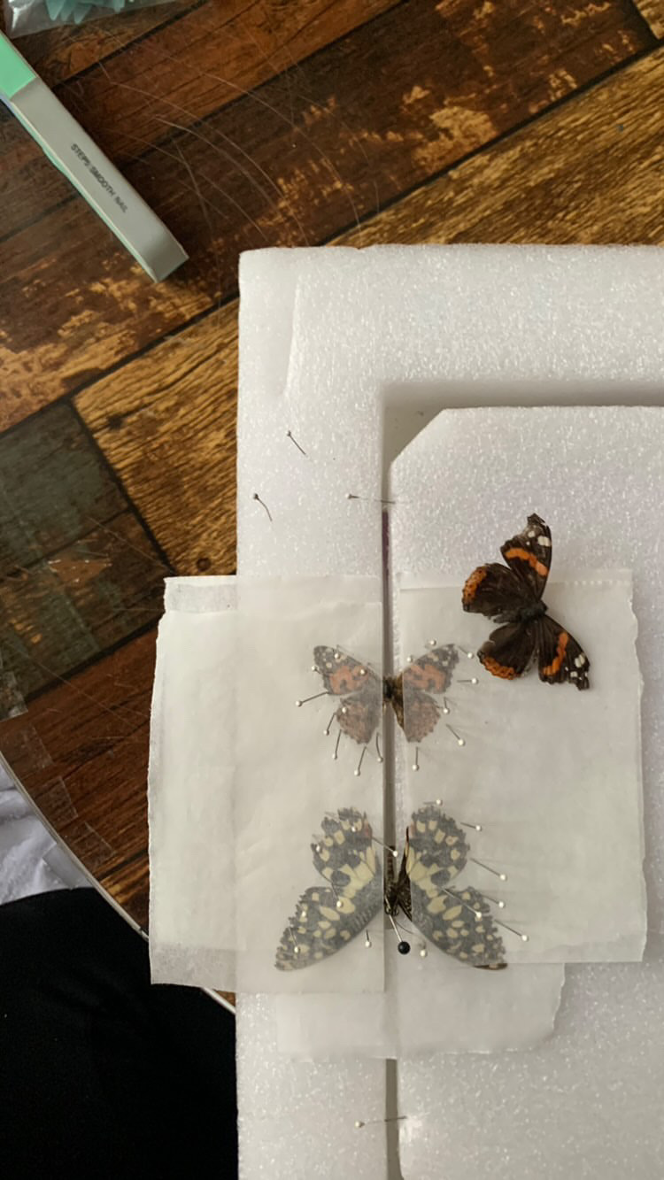
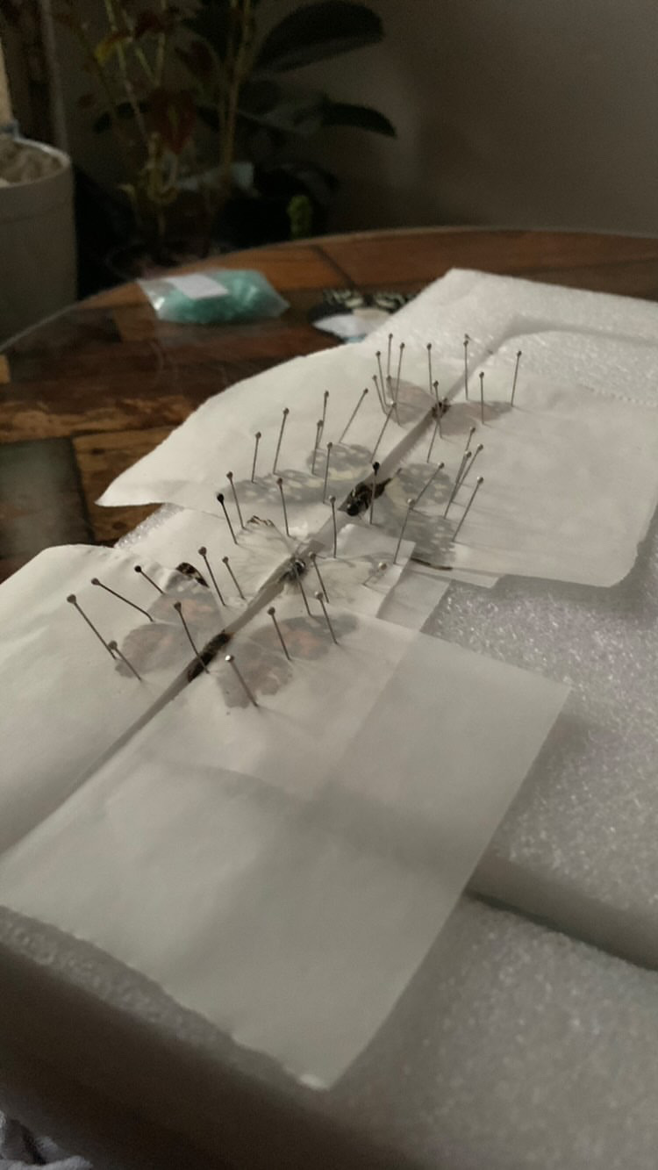
Butterflies mummification

Slide 3
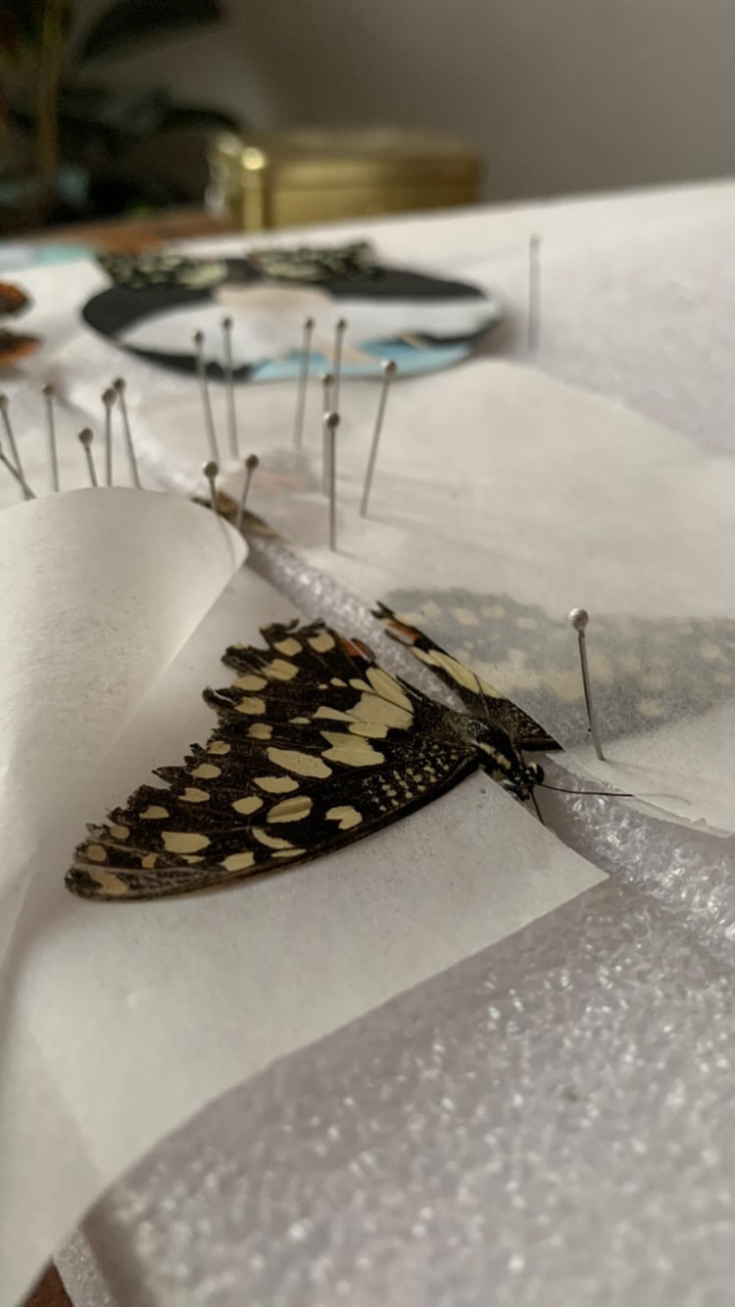
About Butterflies mummification
preservation process that occurs in certain conditions where the butterfly's body is dried and preserved, preventing decomposition. This can happen naturally
we preserve butterflies for their beauty and for ecological importance

Slide 4
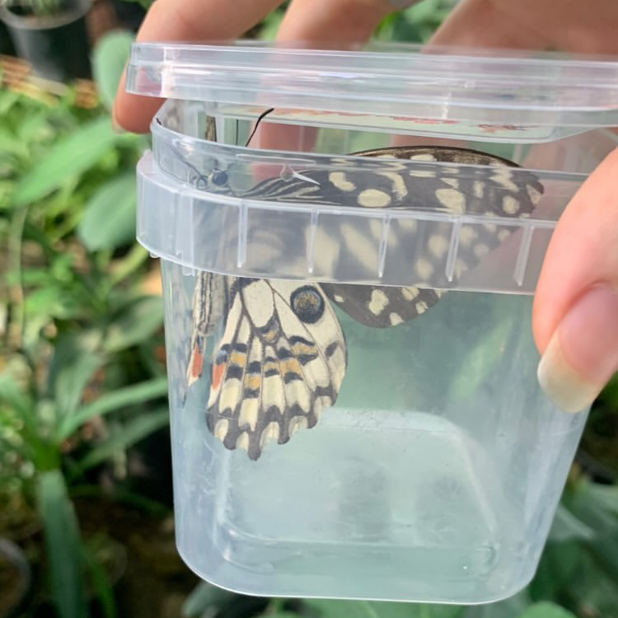
How to mummificate a btterflies
Collection:
01
Gently capture naturly died butterfly or take care of It till it finish its lifetime
02
Cleaning:
Remove any dirts carefully not to break its fragile wings
Preservation:
03
Inject body with alcohol to prevent decay after leaving it in hydration box for 12-48h
04
Drying:
After pinning down the butterfly, we wait for it to aie dry its wings in its opened form

Slide 5
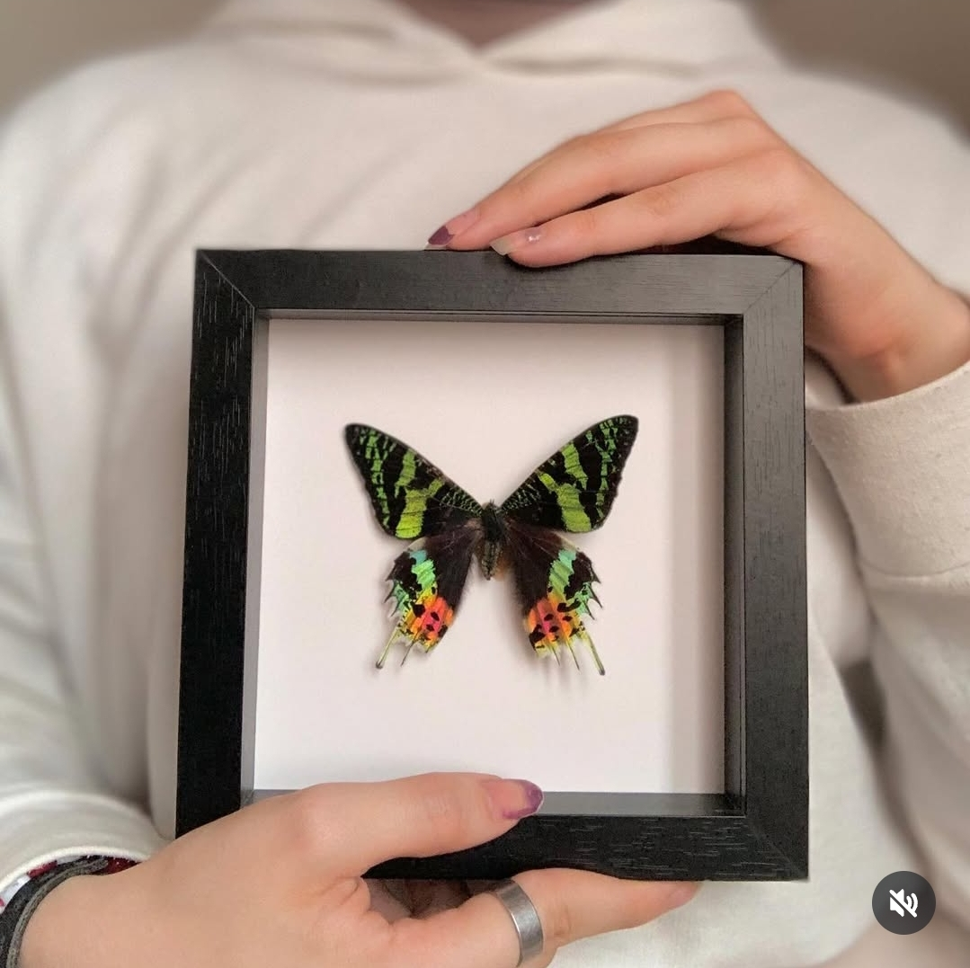
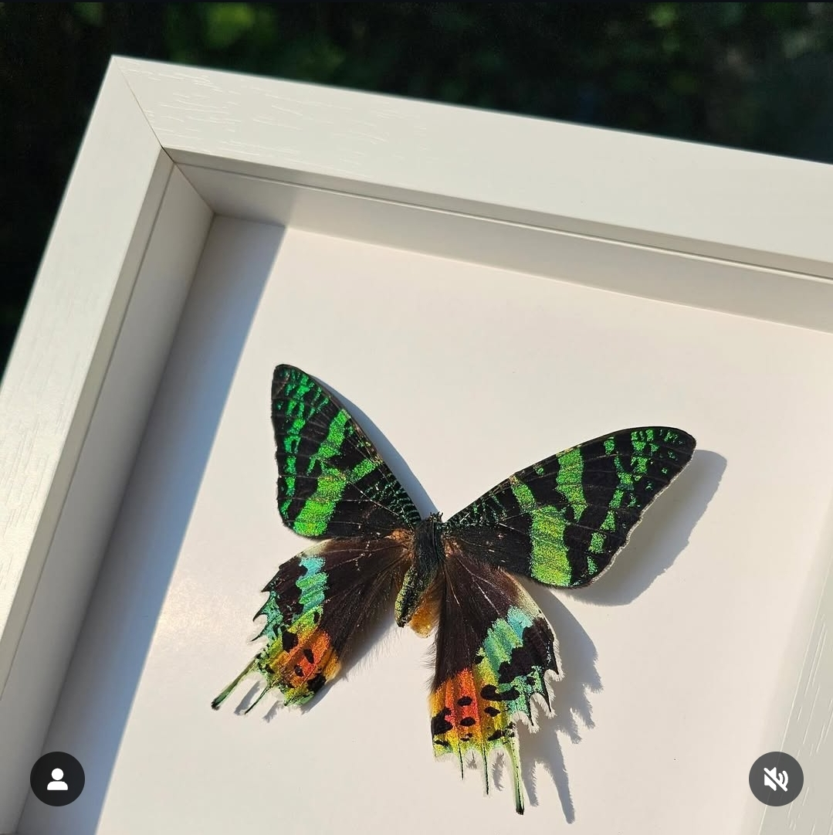
Lifespan of Butterflies
egg | caterpiller | chrysalis | adult
last 3 up to 10 days | Last 2-4weeks Some for several months | Last 1-2weeks Some for several months | Lives 2weeks up to 8months

Slide 6
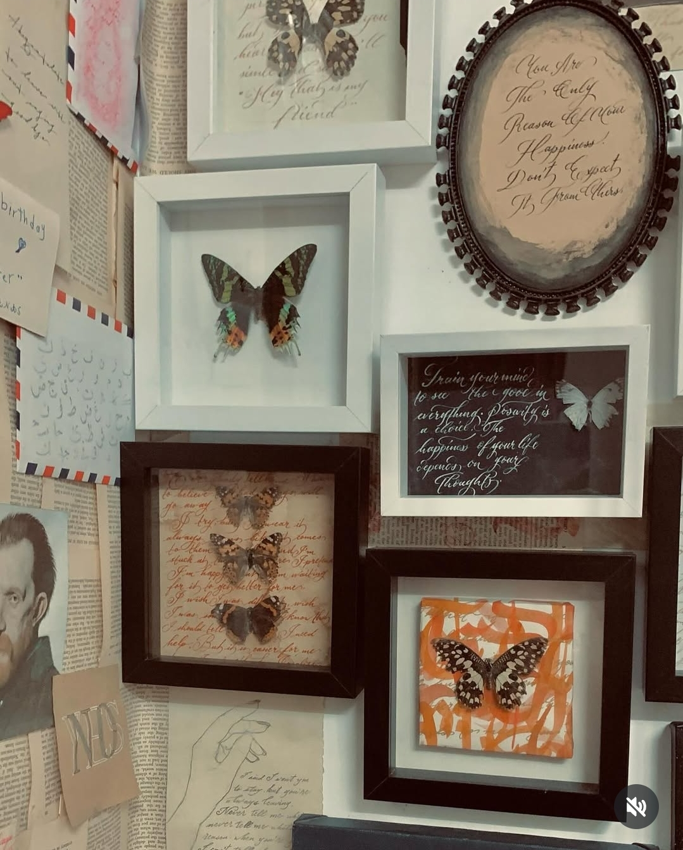

Thank you

